Slide 1
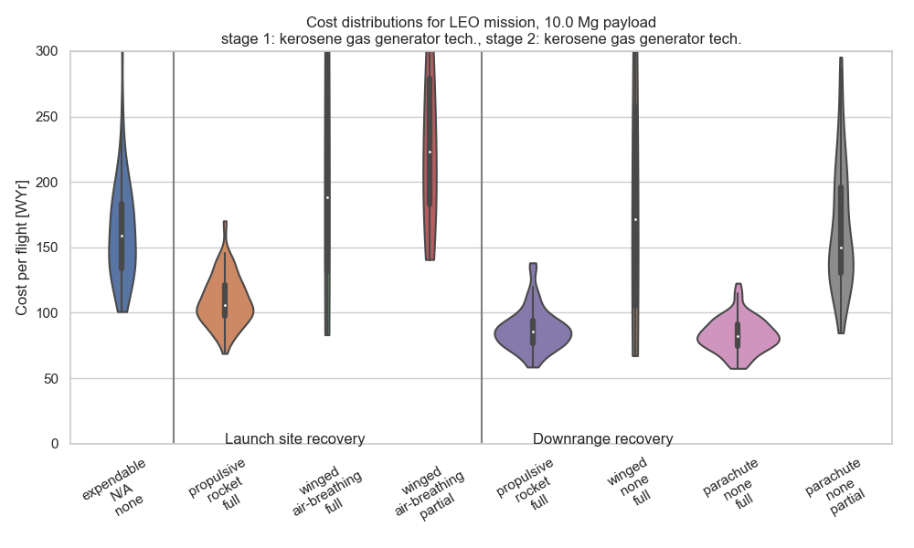
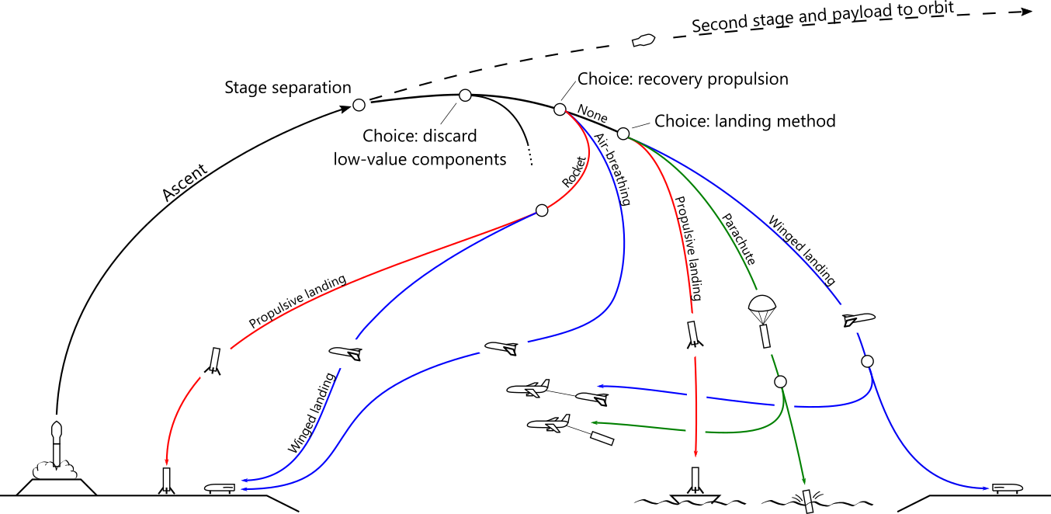
Expendable
Landing method:
Recov. prop. method:
Portion recov’d:

Slide 2
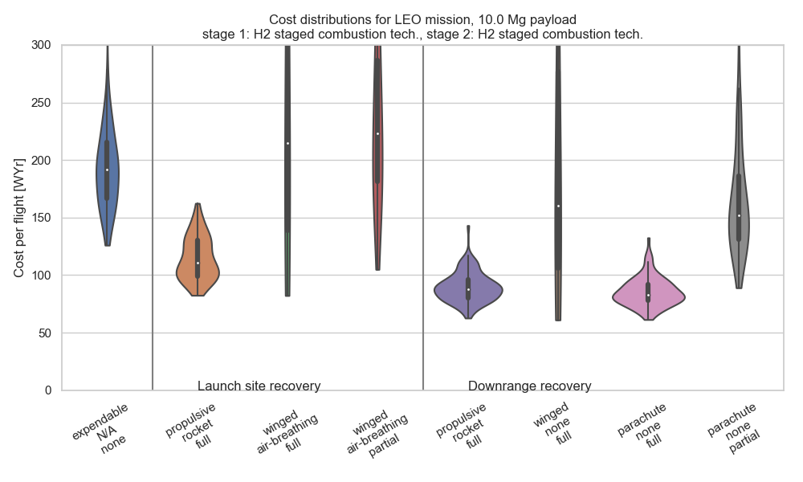
Expendable
Landing method:
Recov. prop. method:
Portion recov’d:

